Slide 1

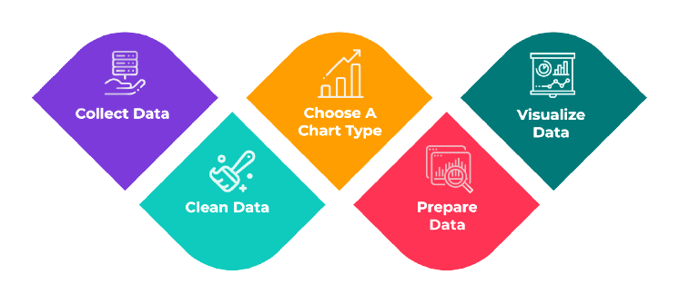


GLA
“A Place to Invent and Learn”
Data Visualization

Slide 2
Lecture 2: Principle of Good Data Visualization

Slide 3

Agenda
Visual Perception
Gestalt Principles
Cognitive Load
Principle of Good Data Visualization

Slide 4
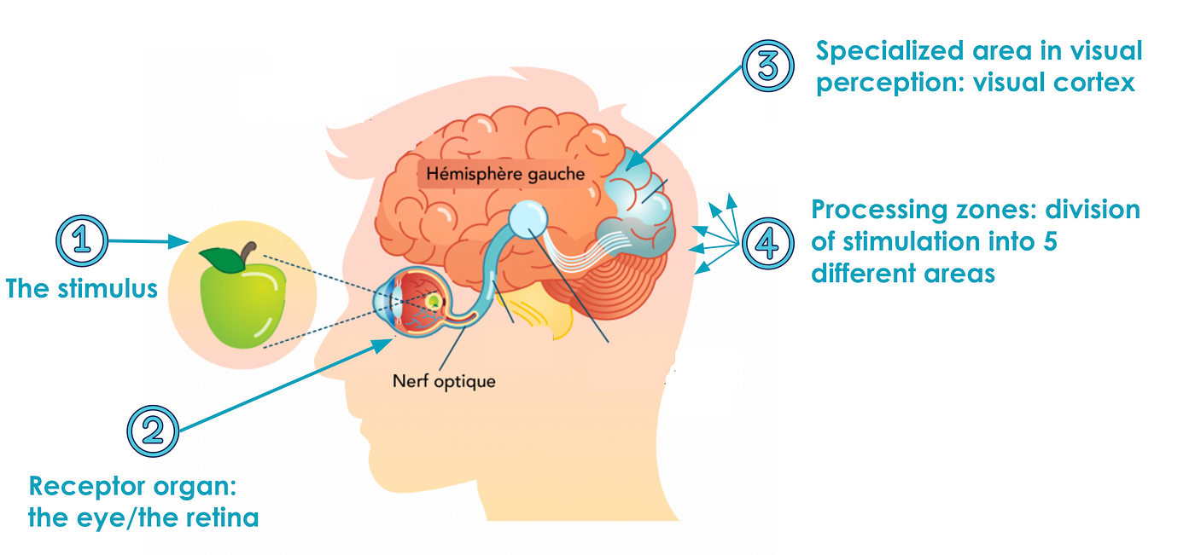

Visual Perception
Visual perception is the process by which the brain interprets and makes sense of visual information received through the eyes. It’s not just about seeing—it's about understanding what is seen.
Sensation vs. Perception
Sensation: The eyes detect light, color, shapes, motion, etc.
Perception: The brain organizes and interprets these sensations to recognize objects, patterns, depth, and meaning.

Slide 5
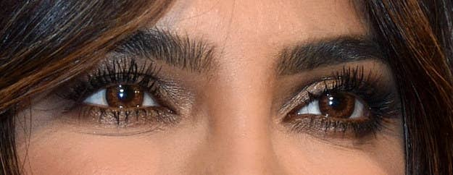

Visual Perception
"This snetecne is esay to raed eevn touhgh the lteetrs in the mdilde are mxied up."
"People can sltil uesdnratnd txet qiuet qlcuiky as lnog as the frsit and lsat lteetrs are in the rgiht pcale."

Slide 6

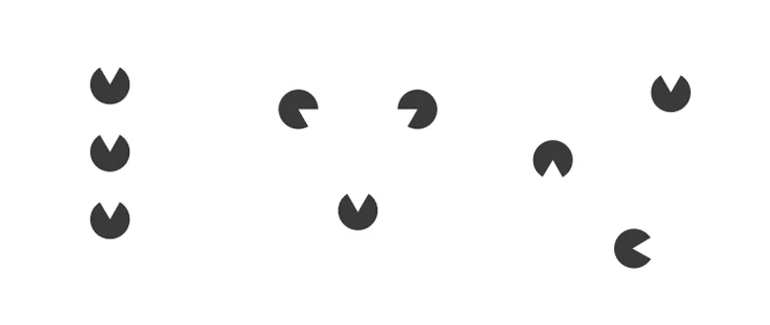

Gestalt Principles
1. Proximity
Elements that are close together are perceived as a group.

Slide 7
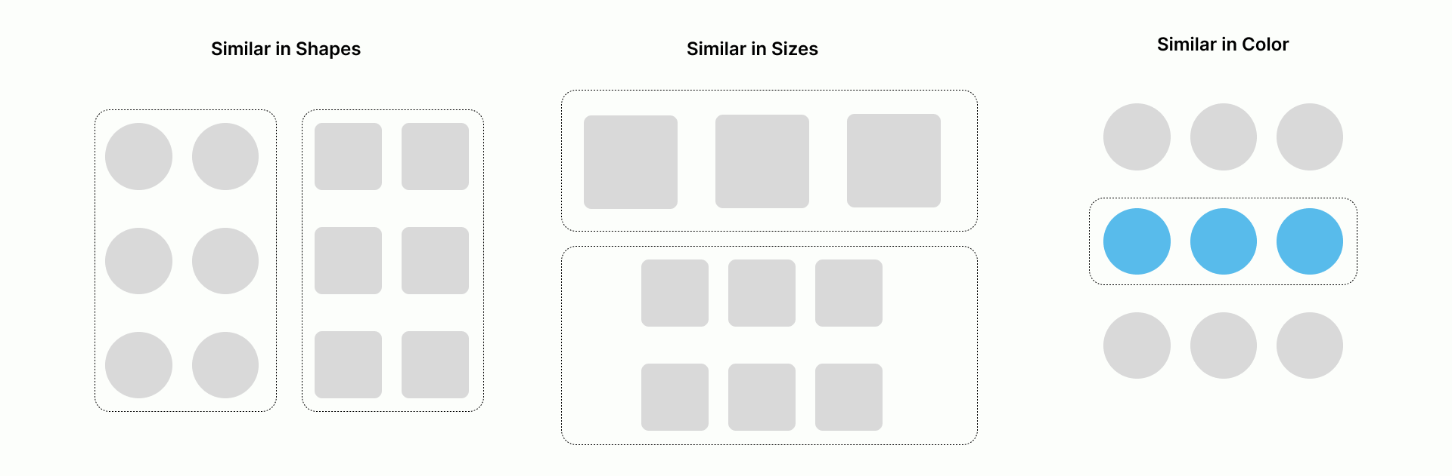
Gestalt Principles
2. Similarity
Things that look similar (color, shape, size) are perceived as belonging together

Slide 8
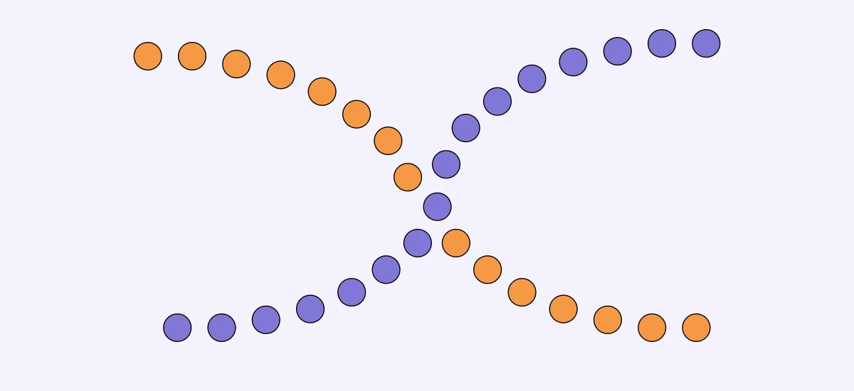
Gestalt Principles
3. Continuity (Good Continuation)
We perceive elements aligned in a smooth line or curve as part of a continuous group.

Slide 9

Gestalt Principles
4. Closure
Our brains fill in missing parts of a design or shape to see a complete figure.

Slide 10

Gestalt Principles
Figure/Ground
We distinguish an object (the figure) from its background (the ground)

Slide 11
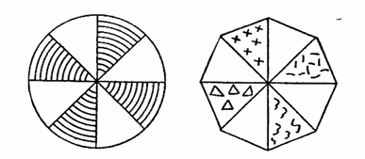
Gestalt Principles
6. Symmetry and Order
We prefer symmetrical and organized patterns. We tend to interpret ambiguous images in the simplest form.

Slide 12
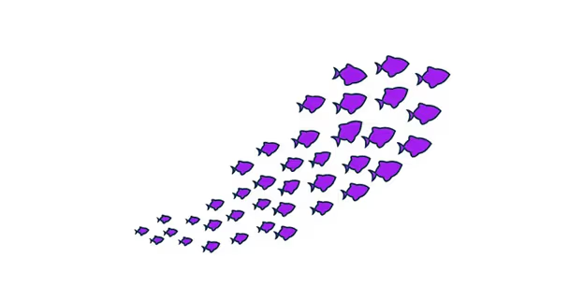
Gestalt Principles
7. Common Fate
Elements moving in the same direction or changing together are seen as related.

Slide 13


Cognitive Load
Cognitive load refers to the amount of mental effort being used in the working memory at any given time. In simple terms, it's how hard your brain has to work to understand or process information.

Slide 14
Cognitive Load
Cognitive load refers to the amount of mental effort being used in the working memory at any given time. In simple terms, it's how hard your brain has to work to understand or process information.

Slide 15

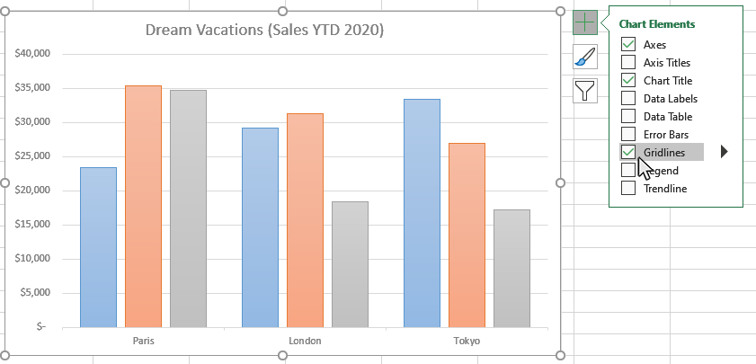
Principle of Good Data Visualization
1. Clarity
Avoid clutter: Remove unnecessary elements (e.g., gridlines, 3D effects).
Use clear labels and legends: Make sure titles, axes, and legends are descriptive and easy to understand.
Highlight key insights: Emphasize the most important data.

Slide 16
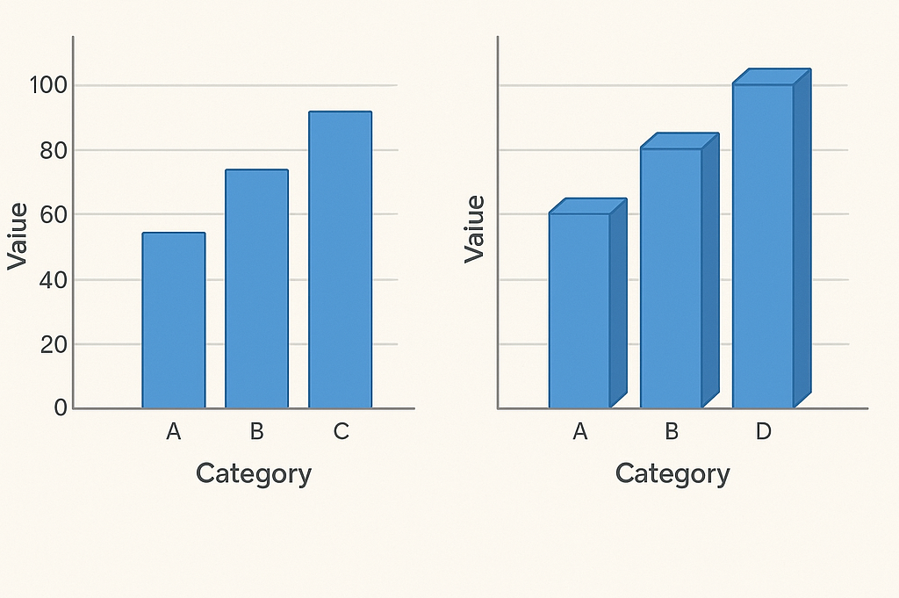
Principle of Good Data Visualization
2.Accuracy
Visuals must represent the data truthfully.
Avoid distortions (e.g., misleading axes or 3D effects).
Maintain consistent scales.

Slide 17
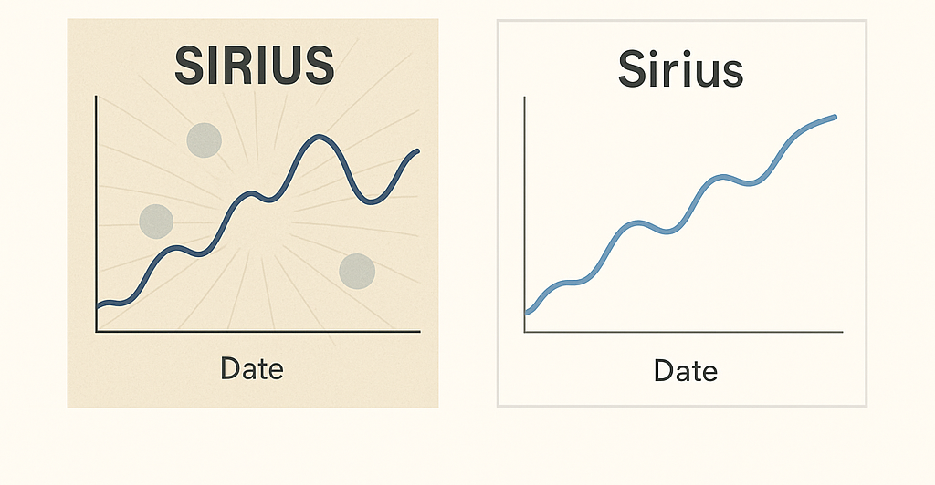
Principle of Good Data Visualization
3. Simplicity
Less is more: Don't overload the chart with too much information.
Avoid chartjunk: Graphics or visuals that don’t add value (e.g., sc).
Use clean fonts: Stick to professional and readable fonts.

Slide 18
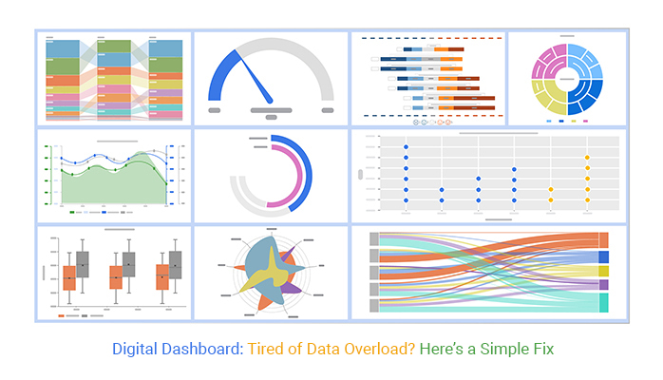
Principle of Good Data Visualization
4. Relevance
Display only data that matters to the purpose.
Avoid overloading with unnecessary dimensions or metrics.

Slide 19
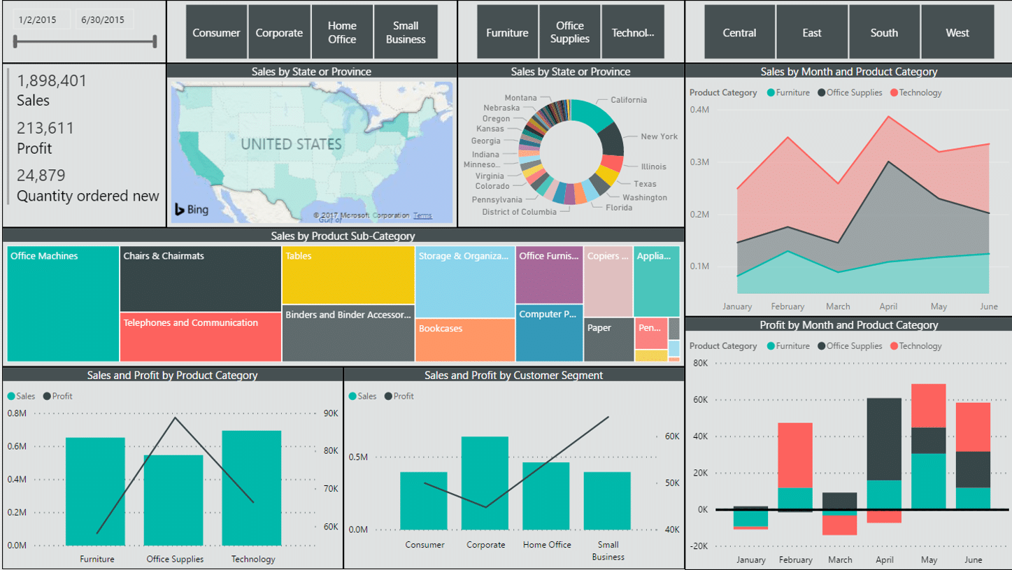
Principle of Good Data Visualization
5. Consistency
Use consistent colors, scales, and design elements across charts.
Follow a visual hierarchy that guides the viewer’s attention.

Slide 20
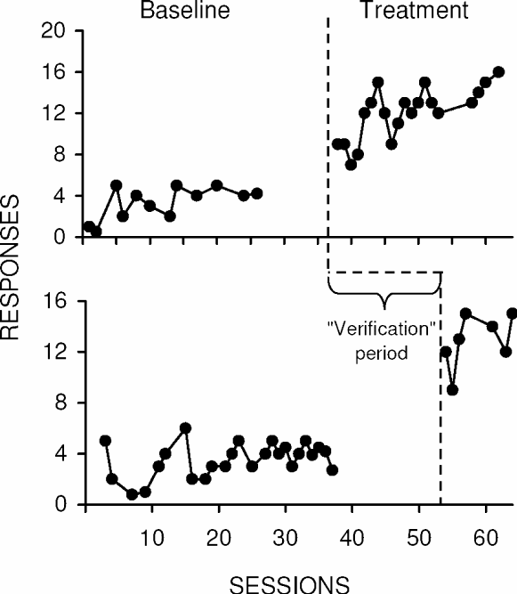
Principle of Good Data Visualization
6. Comparability
Make it easy to compare values across categories or time periods.
Use common baselines and align axes where comparisons are made.

Slide 21
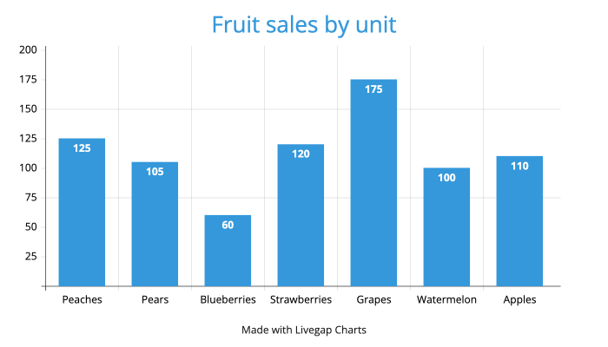
Principle of Good Data Visualization
7. Context
Provide enough context to understand the data (e.g., units, time frames).
Include benchmarks or reference lines when useful.

Slide 22
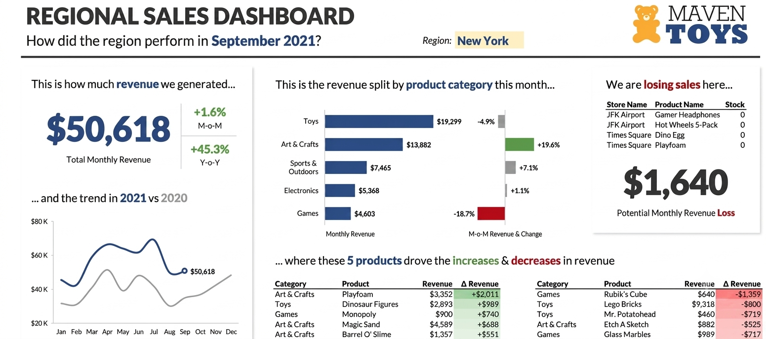
Principle of Good Data Visualization
8. Storytelling
Guide the viewer through the insights.
Use sequencing or dashboards to support narrative flow.

Slide 23
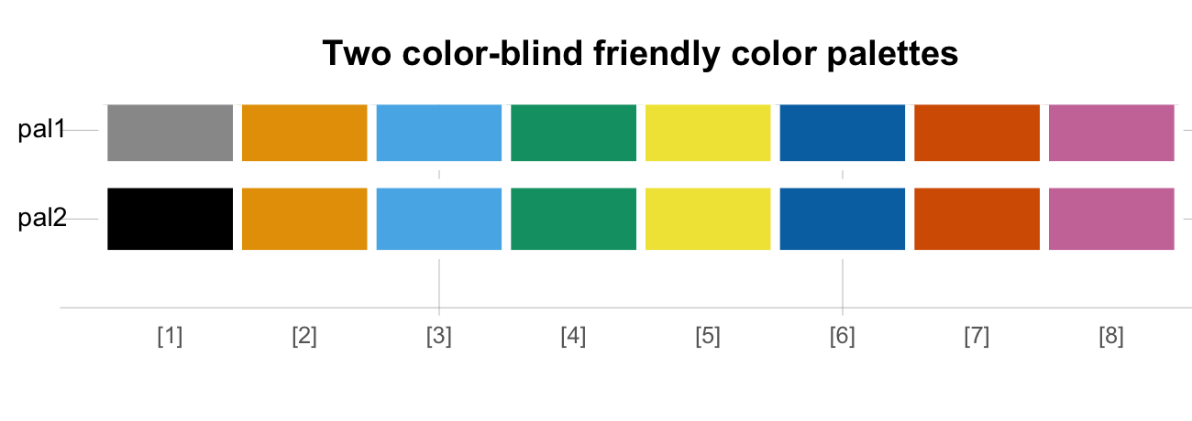
Principle of Good Data Visualization
9.Accessibility
Use colorblind-friendly palettes.
Ensure readability for all audiences (e.g., font size, contrast).

